Slide 1
He for She

Slide 2
He for She is an invitation for men and people of all genders to stand in solidarity with women to create a bold, visible and united force for gender equality.
Here is the link to the movement for more information:
https://www.heforshe.org/en/movement

Slide 3
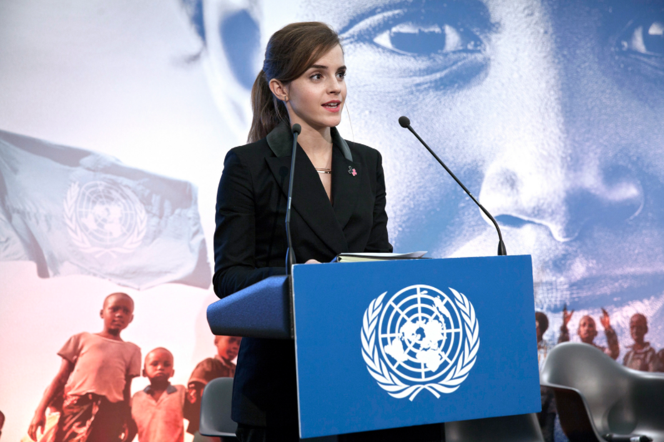
Emma Watson addressed the UN as the Women’s Goodwill Ambassador for the UN as part of the He for She Campaign (2014)

Slide 4
Let’s watch her speech and while doing so bear in mind the following questions:
https://www.youtube.com/watch?v=gkjW9PZBRfk
What is Emma Watson at the UN for?
How does she define feminism?
What does she expect to achieve?
Why does she consider herself lucky?
What does she say about Hilary Clinton’s speech at Beijing in 1977?
What does she say to men and about men?
What facts does she provide?
Any interesting phrases? Why did you find them interesting?

